Slide 1




Structures of Survey Data Exchange Formats
(TA, TB, TC, TE and TL):
proposals for Rapana survey
W. Zupa, M. T. Spedicato

Slide 2
Data exchange formats
Standard formats are defined for the storage and to facilitate the exchange of the data produced by surveys.
The exchange files are in .csv format, using semicolon as field separator
Files type
5 file types defined in order to store and exchange the data:
Type | Description
TA | Characteristics of haul - this file includes the data on bottom temperature and stratification
TB | Catches by haul
TC | Length, sex, and maturity at aggregated level
TE | Age weight and maturity by length at individual level
TL | Collection of marine litter data

Slide 3
TA
Name | Type | Ref. Range | Comments | New range
TYPE_OF_FILE | 2A | TA | Fixed value | TA
Name | Type | Ref. Range | Comments | New range
COUNTRY | 3A | See Annex I |  | BGR,UKR,ROM,GEO,ROU,TUR,TUW,TUE
Code | Country
BGR | Bulgaria
UKR | Ukraine
ROM | Romania
GEO | Georgia
ROU | Russian Federation
TUR | Turkey
TUW | Turkey West
TUE | Turkey East
Country codes in MEDITS (Annex I)
Country codes
Rapana survey

Slide 4
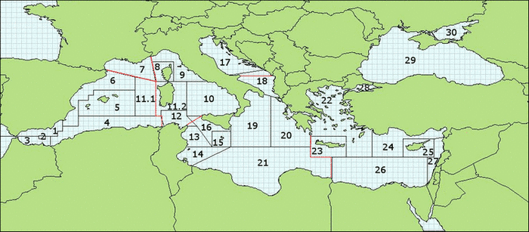
TA
Name | Type | Ref. Range | Comments | New range
AREA | 2N | Annex III | GFCM codes | 1-30
Name | Type | Ref. Range | Comments | New range
VESSEL | 3A | MEDITS Code |  | TSN, SDM, …

Slide 5
Name | Type | Ref. Range | Comments | New range
GEAR | 5AN | GOC73 |  | GOC73, BEAMT,TBB
TA
Name | Type | Ref. Range | Comments | New range
RIGGING | 4AN | GC73 |  | GC73, BT, ROMT, TURT, TURI
Name | Type | Ref. Range | Comments | New range
DOORS | 4AN | WHS8 |  | WHS8, WHS0, ND
MEDITS reference values
Width legs

Slide 6
TA
Name | Type | Ref. Range | Comments | New range
YEAR | 4N |  | Es. 2000 | 1900 - 2100
Name | Type | Ref. Range | Comments | New range
MONTH | 2N | 1 - 12 |  | 1 – 12
Name | Type | Ref. Range | Comments | New range
DAY | 2N | 1 to 28/29/30/31 |  | 1 – 31
Name | Type | Ref. Range | Comments | New range
HAUL_NUMBER | 3N | 1 - 999 | One series by vessel/year | 4AN

Slide 7
TA
Name | Type | Ref. Range | Comments | New range
CODEND_CLOSING | 1A | S, C | S: without; C: controlled | S, C, ND
Name | Type | Ref. Range | Comments | New range
PART_OF_THE_CODEND | 1A | A, M, P, S | Mandatory if codend closing = C; A: anterior, M: middle; P: posterior; S sum of the 3 parts | A, M, P, S, ND
Codend: Netting bag made up of one or more panels (pieces of netting) of the same mesh size attached to one another along their sides in the axis of the trawl by a seam where a side rope may also be attached.

Slide 8
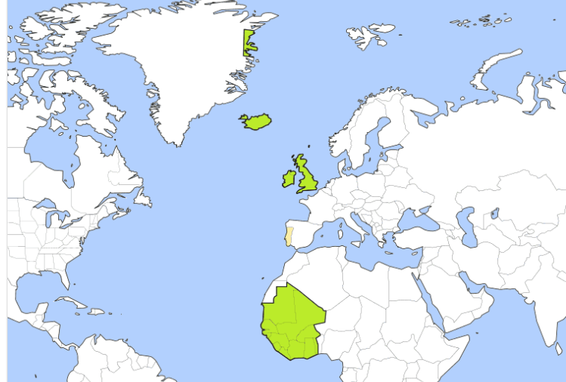
Name | Type | Ref. Range | Comments | New range
SHOOTING_TIME | 4N | 0 to 2400 | In UT Ex: 7 h 25 min 725 | 0 to 2400
TA
Daylight hours
Name | Type | Ref. Range | Comments | New range
HAULING_TIME | 4N | 0 to 2400 | In UT Ex: 7 h 25 min 725 | 0 to 2400
Daylight hours
CONSISTENCY with HAUL_DURATION
HAUL_DURATION | Type | Ref. Range | Comments | New range
HAUL_DURATION | 2N | 5 to 90 | Reported in minutes | 5 to 90
The haul starts when the gear settles on the bottom
The haul ends when the vessel is stopped to retrieve the beam trawl
The haul start and end times should be recorded in UT time (Greenwich Mean Time, GMT) and not in the local time.

Slide 9
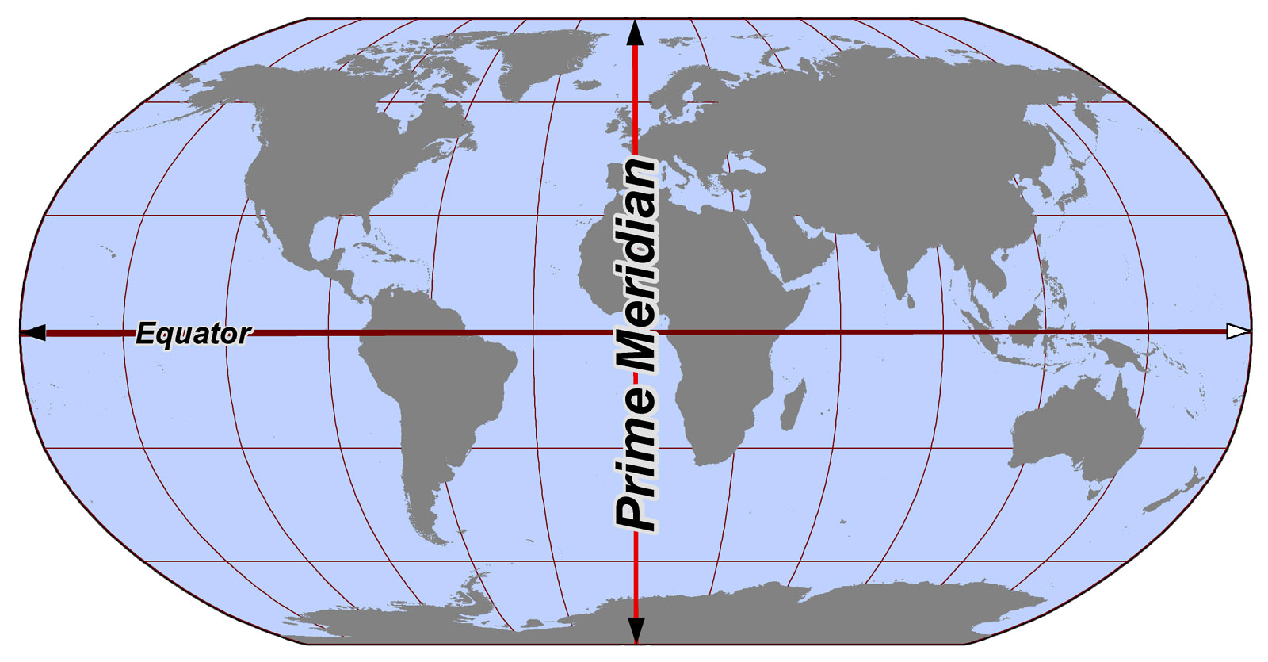
TA
Name | Type | Ref. Range | Comments | New range
SHOOTING_QUADRANT | 1N | 1, 3, 5, 7 |  | 1, 3, 5, 7
Name | Type | Ref. Range | Comments | New range
HAULING_QUADRANT | 1N | 1, 3, 5, 7 |  | 1, 3, 5, 7
7
1
5
3

Slide 10

TA
Name | Type | Ref. Range | Comments | New range
SHOOTING_LATITUDE | 7N | 3400 to 4600 | Ex: 36° 40,22' > 3640,22 | 3020 to 4730
Name | Type | Ref. Range | Comments | New range
SHOOTING_LONGITUDE | 7N | 0 to 3500 | Ex: 4° 19,84' > 419,84 | 0 to 4200
Name | Type | Ref. Range | Comments | New range
HAULING_LATITUDE | 7N | 3400 to 4600 | Ex: 36° 40,22' > 3640,22 | 3020 to 4730
Name | Type | Ref. Range | Comments | New range
HAULING_LONGITUDE | 7N | 0 to 2900 | Ex: 4° 19,84' > 419,84 | 0 to 4200
RoMEBS package function: cood.conv()
MEDITS package function: dd.to.MEDITS()

Slide 11
TA
Name | Type | Ref. Range | Comments | New range
SHOOTING_DEPTH | 3N | 0, 10 to 800 | At the trawl position, in meters; unknown: 0 | 5 to 800
Name | Type | Ref. Range | Comments | New range
HAULING_DEPTH | 3N | 0, 10 to 800 | At the trawl position, in meters; unknown: 0 | 5 to 800
Depending on the GEAR code
GEAR code
GOC73 | 10 - 800
BEAMT TBB | 5 - 35

Slide 12
TA
Name | Type | Ref. Range | Comments | New range
VALIDITY | 1A | V, I | V: valid I: invalid | V, I
Only one ‘VALID’ haul with the same HAUL_NUMBER per YEAR-GSA combination
Name | Type | Ref. Range | Comments | New range
COURSE | 1A | R, N | R: rectilinear N: not rectilinear | R, N
the hauls should be as much as possible rectilinear not to disrupt the trawl geometry
If applicable
to beam trawl
Name | Type | Ref. Range | Comments | New range
DISTANCE | 4N | 1000 to 9000 | Distance over ground in meters | 1000 to 9000

Slide 13
TA
Name | Type | Ref. Range | Comments | New range
RECORDED_SPECIES | 2N | 0, 1, 2, 3, 4 |  | 0, 1, 2, 3, 4
Code | Nature
0 | No standard species recorded
1 | Only the species of the reference list are recorded
2 | The species of the reference list plus some others are recorded
3 | All the caught species are recorded
4 | Species from a national list

Slide 14
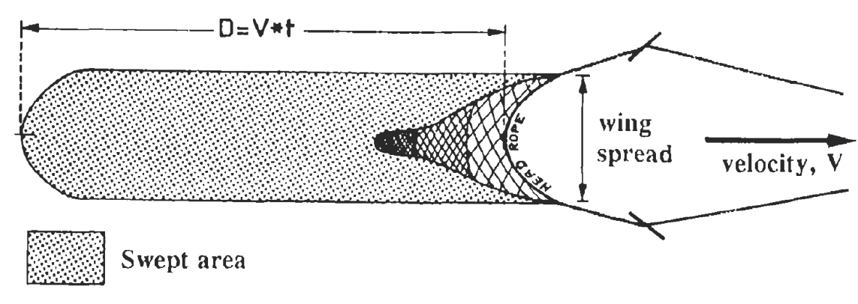

TA
Name | Type | Ref. Range | Comments | New range
VERTICAL_OPENING | 3N | 10 to 100 | In decimeters | -1, 10 to 100
Name | Type | Ref. Range | Comments | New range
WING_OPENING | 3N | 50 to 250 | In decimeters | 30, 50 to 250
Name | Type | Ref. Range | Comments | New range
GEOMETRICAL_PRECISION | 1A | M, E | M: measured E: estimated | M, E
Swept area = DISTANCE * WING_OPENING
DISTANCE is expressed in meters
WING_OPENING is expressed in decimeters

Slide 15
TA
Name | Type | Ref. Range | Comments | New range
BRIDLES_LENGTH | 3N | 100, 150 or 200 | In meters | -1, 100, 150, 200
Name | Type | Ref. Range | Comments | New range
WARP_LENGTH | 4N | 100 to 2200 | In meters | -1, 70:2200
Depending on the GEAR code
GEAR code | WARP_LENGTH
GOC73 | -1, 100:2200
BEAMT TBB | -1, 70:275
Name | Type | Ref. Range | Comments | New range
WARP_DIAMETER | 2N | 10 to 30 | In millimeters | 10 to 30

Slide 16
TA
Name | Type | Ref. Range | Comments | New range
HYDROLOGICAL_STATION | 5N or 2A | National coding or NA if not available
Name | Type | Ref. Range | Comments | New range
OBSERVATIONS | 1N | 0 to 9 | MEDITS code | 0 to 9
MEDITS code | Nature
0 | No problem
1 | Slight plugging of the net
2 | Heavy plugging of the net
3 | High abundance of jellyfish
4 | Species from a national list
5 | Tears of the net
6 | High abundance of benthos
7
8
9 | Other

Slide 17
TA
Name | Type | Ref. Range | Comments | New range
BOTTOM_TEMPERATURE_BEGINNING | 5N or 2A | 0 to 30 | in °C with two decimals; NA if not available | 0 to 30
BOTTOM_TEMPERATURE_END | 5N or 2A | 0 to 30 | in °C with two decimals; NA if not available | 0 to 30
Name | Type | Ref. Range | Comments | New range
BOTTOM_SALINITY_BEGINNING | 5N or 2A | 0 to 50 | in ppt with two decimals; NA if not available | 0 to 50
BOTTOM_SALINITY_END | 5N or 2A | 0 to 50 | in ppt with two decimals; NA if not available | 0 to 50

Slide 18
TA
Name | Type | Ref. Range | Comments | New range
MEASURING_SYSTEM (temperature) | 2A | VA,SO,XA,SA,SI,CT,SB,CD | NA if not available | VA,SO,XA,SA,SI, CT,SB,CD,ND, new codes?
MEASURING_SYSTEM_SALINITY | 2A | VA,SO,XA,SA,SI,CT,SB,CD | NA if not available | VA,SO,XA,SA,SI, CT,SB,CD,ND, new codes?
System | Code | Notes
Vemco- Minilog TDR -5 to +35 C° | VA
Star Oddi temperature sensor | SO
XBT | XA
SCANMAR | SA
SCANMARSIMRAD | SI
CTD probe | CT
SBE 56 | SB | Temperature logger introduced by GSA19 in 2013
CTD probe SBE 37 | CD

Slide 19
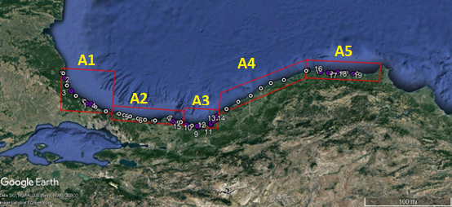
TA
Name | Type | Ref. Range | Comments | New range
NUMBER_OF_THE_STRATUM | 6AN | MEDITS Annex II |  | Stratification table
GSA | COUNTRY | STRATUM | CODE | SURF | MIN_DEPTH | MAX_DEPTH
29 | ROM | ROM1 | 1 | 1418 | 5 | 15
29 | ROM | ROM2 | 2 | 1662.4 | 15 | 25
29 | ROM | ROM3 | 3 | 2437.3 | 25 | 35
29 | BGR | IFR1 | 1 | 679.017 | 5 | 15
29 | BGR | IFR2 | 2 | 1222.94 | 15 | 25
29 | BGR | IFR3 | 3 | 974.363 | 25 | 35
29 | BGR | IFR4 | 4 | 1433.386 | 35 | 45
GSA | COUNTRY | STRATUM | CODE | SURF | MIN_DEPTH | MAX_DEPTH
29 | TUW | TWA_1 | 1 | 64.771 | 5 | 15
29 | TUW | TWA_2 | 2 | 93.141 | 15 | 25
29 | TUW | TWA_3 | 3 | 120.5 | 25 | 35
29 | TUW | TWB_1 | 1 | 29.495 | 5 | 15
29 | TUW | TWB_2 | 2 | 42.019 | 15 | 25
29 | TUW | TWB_3 | 3 | 86.925 | 25 | 35
29 | TUW | TWC_1 | 1 | 75.868 | 5 | 15
29 | TUW | TWC_2 | 2 | 101.92 | 15 | 25
29 | TUW | TWC_3 | 3 | 102.983 | 25 | 35
29 | TUW | TWD_1 | 1 | 41.24 | 5 | 15
29 | TUW | TWD_2 | 2 | 48.996 | 15 | 25
29 | TUW | TWD_3 | 3 | 63.627 | 25 | 35
29 | TUW | TWE_1 | 1 | 35.985 | 5 | 15
29 | TUW | TWE_2 | 2 | 55.729 | 15 | 25
29 | TUW | TWE_3 | 3 | 109.078 | 25 | 35
TWA
TWE
TWD
TWB
TWC

Slide 20
Name | Type | Ref. Range | Comments | New range
TYPE_OF_FILE | 2A | TB | Fixed value | TB
TB
Same formats as in TA table
TB FIELDS
TYPE_OF_FILE
COUNTRY
AREA
VESSEL
YEAR
MONTH
DAY
HAUL_NUMBER
CODEND_CLOSING
PART_OF_THE_CODEND
Name | Type | Ref. Range | Comments | New range
FAUNISTIC_CATEGORY | 3A | See Annexe V | MEDITS code
CODE |  | Description |  | CODE |  | Description
A |  | Fish |  | E |  | Other animal species but not commercial (not edible)
 | Ae | Fish Chondrichthyes |  |  | Emb | Mollusca Bivalvia
 | Ao | Fish Osteichthyes |  |  | Emg | Mollusca Gastropoda
B |  | Crustaceans (Decapoda) |  |  | Emo | Mollusca Opistobranchia
 | Bst | Stomatopoda |  |  | Emp | Mollusca Polyplacophora
C |  | Cephalopods |  | G |  | Portions or products of animal species (shell debris, eggs of gastropods, selachians, etc.)
D |  | Other commercial (edible) species |  | H |  | Portions or products of vegetal species (e.g. leaves of sea grasses, of terrestrial plants, etc.)
 | Dec | Echinodermata |  | M |  | Mammalia (mammals)
 | Dmb | Mollusca Bivalvia |  | O |  | Aves (birds)
 | Dmg | Mollusca Gastropoda |  | R |  | Reptilia (Turtles)
 | Dmo | Mollusca Opistobranchia |  | V |  | Plantae (vegetals)
Part of the table

Slide 21
TB
Name | Type | Ref. Range | Comments | New range
GENUS | 4A | TM Reference List |  | Updated Reference List
Name | Type | Ref. Range | Comments | New range
SPECIES | 3A | TM Reference List |  | Updated Reference List
Name | Type | Ref. Range | Comments | New range
NAME_OF_THE_REFERENCE_LIST | 2A | FM, TM |  | TM

Slide 22
TB
Name | Type | Ref. Range | Comments | New range
TOTAL_WEIGHT_IN_THE_HAUL | 7N | 0 to 9999999 | For the given species, in grams
Name | Type | Ref. Range | Comments | New range
TOTAL_NUMBER_IN_THE_HAUL | 7N | 0 to 9999999 | For the given species. Should be equal to the sum of the 3 following fields.
Name | Type | Ref. Range | Comments | New range
NB_OF_FEMALES | 7N | 0 to 9999999
Name | Type | Ref. Range | Comments | New range
NB_OF_MALES | 7N | 0 to 9999999
Name | Type | Ref. Range | Comments | New range
NB_OF_UNDETERMINED | 7N | 0 to 9999999 | Undetermined or not determined
CONSISTENCY with TC DATA: NO_OF_INDIVIDUAL_OF_THE_ABOVE_SEX_MEASURED,
NUMBER_OF_INDIVIDUALS_IN_THE_LENGTH_ CLASS_AND_MATURITY_STAGE

Slide 23
Name | Type | Ref. Range | Comments | New range
TYPE_OF_FILE | 2A | TC | Fixed value | TC
TC
Same formats as in TA and TB tables
TC FIELDS
TYPE_OF_FILE | HAUL_NUMBER
COUNTRY | CODEND_CLOSING
AREA | PART_OF_THE_CODEND
VESSEL | FAUNISTIC_CATEGORY
YEAR | GENUS
MONTH | SPECIES
DAY
Name | Type | Ref. Range | Comments | New range
LENGTH_CLASSES_CODE | 1A or 1N | m, 0, 1 | MEDITS code
Code | Nature
m | 1 mm
0 | 0.5 cm
1 | 1 cm

Slide 24
TC
Name | Type | Ref. Range | Comments
WEIGHT_OF_THE_FRACTION | 6N | 0 to 999999 | Weight of the fraction in the whole haul in grams
Name | Type | Ref. Range | Comments
WEIGHT_OF_THE_SAMPLE_MEASURED | 6N | 0 to 999999 | Weight of the sample really measured for length, sex and maturity stages (in grams)
Name | Type | Ref. Range | Comments
SEX | 1A | M, F, I, N
Code | Nature
M | Male
F | Female
I | Indetermined
N | Not determined
Sex N should be used in case of species for which sex determination is not mandatory

Slide 25
TC
Name | Type | Ref. Range | Comments
NO_OF_INDIVIDUAL_OF_THE_ABOVE_SEX_MEASURED | 6N | 0 to 999999 | Number of individuals of the above sex measured in the sample
Name | Type | Ref. Range | Comments
LENGTH_CLASS | 4N | 1 to 9999 | Identifier: lower limit of the class in mm; e.g. 30.5-31 cm ->305 (LENGTH_CLASS_CODE:0)
Name | Type | Ref. Range | Comments
MATURITY | 1N or 2A | 0 to 4, ND: not determined
Not Determined code (ND) was included in case length measures only were taken
Name | Type | Ref. Range | Comments
MATSUB | 2A | From A to E, ND: not determined
this field should be specified even when stage is 1 or 2, it cannot be 0 or empty

Slide 26
Relationship between TB and TC
TB
TYPE_OF_FILE | HAUL_NUMBER | FAUNISTIC_CATEGORY | GENUS | SPECIES | TOTAL_WEIGHT_IN_THE_HAUL | TOTAL_NUMBER_IN_THE_HAUL | NB_OF_FEMALES | NB_OF_MALES | NB_OF_UNDETERMINED
TB | 2 | Ao | SPIC | FLE | 7560 | 864 | 816 | 0 | 48
TC
WEIGHT_OF_THE_FRACTION / WEIGHT_OF_THE_SAMPLE_MEASURED = SUBSAMPLE RATIO
TYPE_OF_FILE | HAUL_NUMBER | GENUS | SPECIES | WEIGHT_OF_THE_FRACTION | WEIGHT_OF_THE_SAMPLE_MEASURED | SEX | NO_OF_INDIVIDUAL_OF_THE_ABOVE_SEX_MEASURED | LENGTH_CLASS | MATURITY | MATSUB | NUMBER_OF_INDIVIDUALS_IN_THE_LENGTH_CLASS_AND_MATURITY_STAGE |  | RATIO | Expansion
TC | 2 | SPIC | FLE | 7560 | 3780 | I | 24 | 45 | 0 |  | 12 |  | 2 | 24
TC | 2 | SPIC | FLE | 7560 | 3780 | I | 24 | 50 | 0 |  | 9 |  | 2 | 18
TC | 2 | SPIC | FLE | 7560 | 3780 | I | 24 | 55 | 0 |  | 3 |  | 2 | 6
TC | 2 | SPIC | FLE | 7560 | 3780 | F | 408 | 75 | 2 | A | 2 |  | 2 | 4
TC | 2 | SPIC | FLE | 7560 | 3780 | F | 408 | 80 | 2 | A | 5 |  | 2 | 10
TC | 2 | SPIC | FLE | 7560 | 3780 | F | 408 | 85 | 2 | A | 57 |  | 2 | 114
TC | 2 | SPIC | FLE | 7560 | 3780 | F | 408 | 90 | 2 | A | 125 |  | 2 | 250
TC | 2 | SPIC | FLE | 7560 | 3780 | F | 408 | 95 | 2 | A | 128 |  | 2 | 256
TC | 2 | SPIC | FLE | 7560 | 3780 | F | 408 | 95 | 4 | B | 16 |  | 2 | 32
TC | 2 | SPIC | FLE | 7560 | 3780 | F | 408 | 100 | 2 | A | 42 |  | 2 | 84
TC | 2 | SPIC | FLE | 7560 | 3780 | F | 408 | 100 | 4 | B | 22 |  | 2 | 44
TC | 2 | SPIC | FLE | 7560 | 3780 | F | 408 | 105 | 3 |  | 2 |  | 2 | 4
TC | 2 | SPIC | FLE | 7560 | 3780 | F | 408 | 105 | 4 | B | 8 |  | 2 | 16
TC | 2 | SPIC | FLE | 7560 | 3780 | F | 408 | 110 | 3 |  | 1 |  | 2 | 2
Sum = 24
Sum = 408

Slide 27
Subsampling in TC
Fraction
any sub-group of individual from the total catch of a species (males, females, large sized individuals, small individuals, juveniles, etc.) on which it could be proceed to a sub-sample.
Sub-sampling for size
TB
TOTAL_WEIGHT_IN_THE_HAUL | TOTAL_NUMBER_IN_THE_HAUL | NB_OF_FEMALES | NB_OF_MALES | NB_OF_UNDETERMINED
1000 | 912 | 341 | 571 | 0
TC
WEIGHT_OF_THE_ FRACTION | WEIGHT_OF_THE_ SAMPLE_MEASURED | SEX | NO_OF_INDIVIDUAL_OF_THE_ABOVE_SEX_MEASURED | LENGTH_CLASS | MATURITY | MATSUB | NUMBER_OF_INDIVIDUALS_IN_THE_LENGTH_CLASS_AND_ MATURITY_STAGE
900 | 90 | F | 34 | 40 | ND | ND | 9
900 | 90 | F | 34 | 45 | ND | ND | 10
900 | 90 | F | 34 | 50 | ND | ND | 15
900 | 90 | M | 57 | 40 | ND | ND | 12
900 | 90 | M | 57 | 45 | ND | ND | 15
900 | 90 | M | 57 | 50 | ND | ND | 18
900 | 90 | M | 57 | 55 | ND | ND | 12
100 | 100 | F | 1 | 125 | ND | ND | 1
100 | 100 | M | 1 | 130 | ND | ND | 1
1/10
1/1

Slide 28

Name | Type | Ref. Range | Comments | New range
TYPE_OF_FILE | 2A | TE | Fixed value | TE
TE
Same formats as in TA, TB and TC tables
TE FIELDS
TYPE_OF_FILE | PART_OF_THE_CODEND
COUNTRY | FAUNISTIC_CATEGORY
AREA | GENUS
VESSEL | SPECIES
YEAR | LENGTH_CLASSES_CODE
MONTH | SEX
DAY | LENGTH_CLASS
FAUNISTIC_CATEGORY | MATURITY
HAUL_NUMBER | MATSUB
CODEND_CLOSING
LENGTH_CLASSES_CODE and LENGTH_CLASS between TC and TE should be consistent.
Name | Type | Ref. Range | Comments | New range
NO_PER_SEX_MEASURED_IN_SUB_ SAMPLE_FOR_OTOLITH (name to be changed in NO_PER_SEX_MEASURED_IN_SUB_ SAMPLE_FOR_HARD_STRUCTURE) | 6N | 0 to 999999 | Number of individuals of the above sex measured in the sub-sample for otolith
INDIVIDUAL INFORMATION
HAUL_NUMBER | FAUNISTIC_CATEGORY | GENUS | SPECIES | LENGTH_CLASSES_CODE | SEX | NO_PER_SEX_MEASURED_IN_SUB_SAMPLE_FOR_OTOLITH | LENGTH_CLASS
2 | Ao | MERL | MER | 0 | M | 3 | 195
2 | Ao | MERL | MER | 0 | M | 3 | 240
2 | Ao | MERL | MER | 0 | M | 3 | 250

Slide 29

TE
Name | Type | Ref. Range | Comments
SHELL_WIDTH | 6N or 2A | 0.1 to 999999; ND: not determined | Width is in mm
Name | Type | Ref. Range | Comments
INDIVIDUAL_WEIGHT (to be modified in BRUT_WEIGHT) | 6N or 2A | 0.1 to 999999; ND: not determined | The weight is in grams and decimals are allowed (e.g. 2.5)
Name | Type | Ref. Range | Comments
CLEAN_WEIGHT | 6N or 2A | 0.1 to 999999; ND: not determined | The weight is in grams and decimals are allowed (e.g. 2.5)
Name | Type | Ref. Range | Comments
NO_PER_SEX_MEASURED_IN_SUB_ SAMPLE_FOR_WEIGHT | 6N | 0 to 999999 | Number of individuals of the above sex measured in the sub-sample for individual weight. In case otoliths are taken, individual weight should be reported
INDIVIDUAL INFORMATION
LENGTH_CLASSES_CODE | SEX | LENGTH_CLASS | SHELL_WIDTH | BRUT_WEIGHT | CLEAN_WEIGHT | NO_PER_SEX_MEASURED_IN_SUB_SAMPLE_FOR_WEIGHT
0 | M | 200 | NEW FIELD | 66.5 | NEW FIELD | 4
0 | M | 240 | NEW FIELD | 106.5 | NEW FIELD | 4
0 | M | 255 | NEW FIELD | 146.9 | NEW FIELD | 4
0 | M | 265 | NEW FIELD | 160.5 | NEW FIELD | 4

Slide 30
TE
Name | Type | Ref. Range | Comments
OTOLITH_SAMPLED (name to be changed in “HARD_STRUCTURE_SAMPLED”) | 2A | Y or N* for Teleosts and NR for the other species | O: otolith; S: shell; V: vertebrae; … N: hard structure not sampled; NR: not requested
*in case, for example, the individual is sampled for the individual weight only
Name | Type | Ref. Range | Comments
NO_PER_SEX_MEASURED_IN_SUB_ SAMPLE_FOR_AGEING | 6N | 0 to 999999 | Number of individuals of the above sex measured in the sub-sample for ageing
Name | Type | Ref. Range | Comments
OTOLITH_READ (name to be changed in “HARD_STRUCTURE_READ”) | 2A | Y or N for Teleosts; NR for the other species | NR: not requested; Y: hard structure read; N: hard structure not read
Info in NO_PER_SEX_MEASURED_IN_SUB_ SAMPLE_FOR_AGEING and OTOLITH_READ
should be consistent

Slide 31
TE
Name | Type | Ref. Range | Comments
AGE | 4N or 2A | -1 to 99 for Teleosts, UR for unreadable, NR for the other species; -1 reading in progress or length class completed | Also decimal number for age (e.g. 10.5); NR: not requested;
Name | Type | Ref. Range | Comments
OTOLITH_CODE | 35AN | [Country][GSA][Vessel][Year][Haul] [Genr_Spec][Stage][Sex][Length] [individual code], NR | ITA10PEC2012100MULL_BAR2AM110_xxxxxx
Name | Type | Ref. Range | Comments
RECORD_NUMBER | 6N | 0 to 100.000 | Record identifier by year

